Slide 1
Branding and style guides
Yukiko Ishida

Slide 3
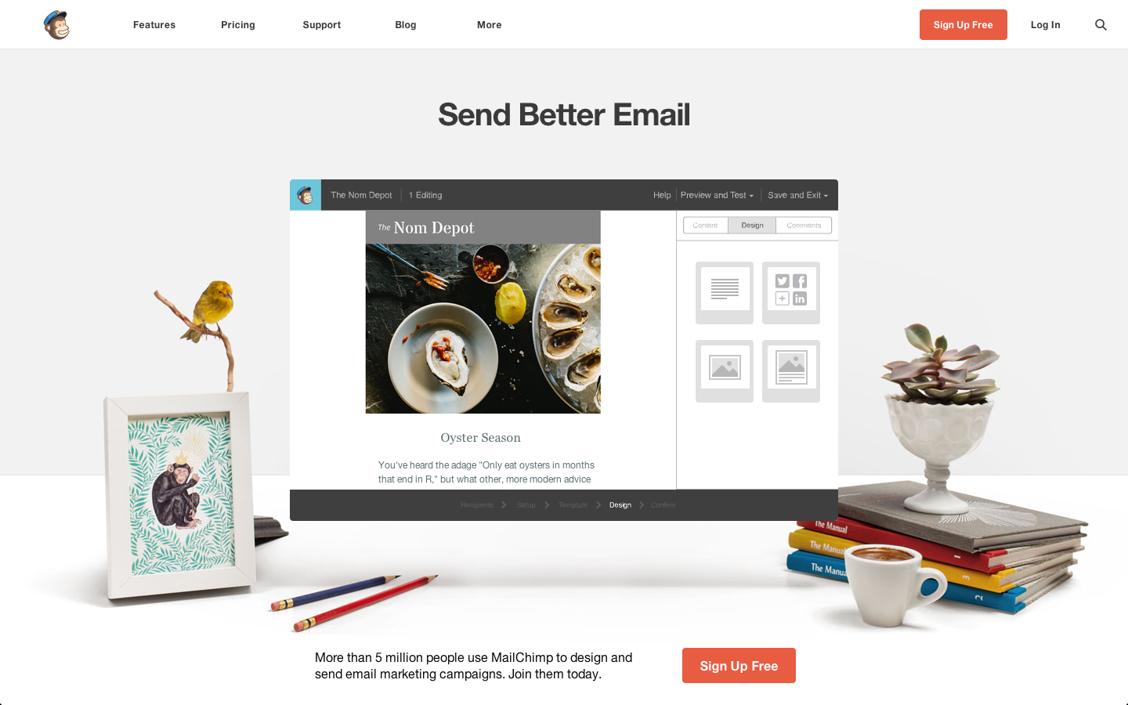

Slide 4
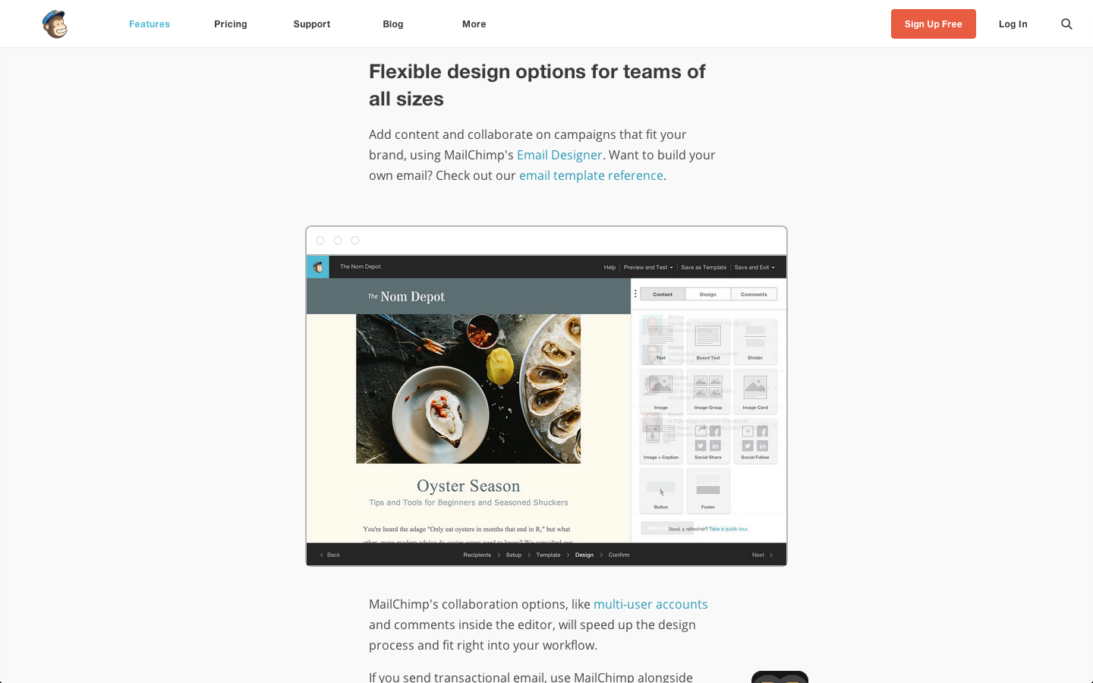

Slide 5
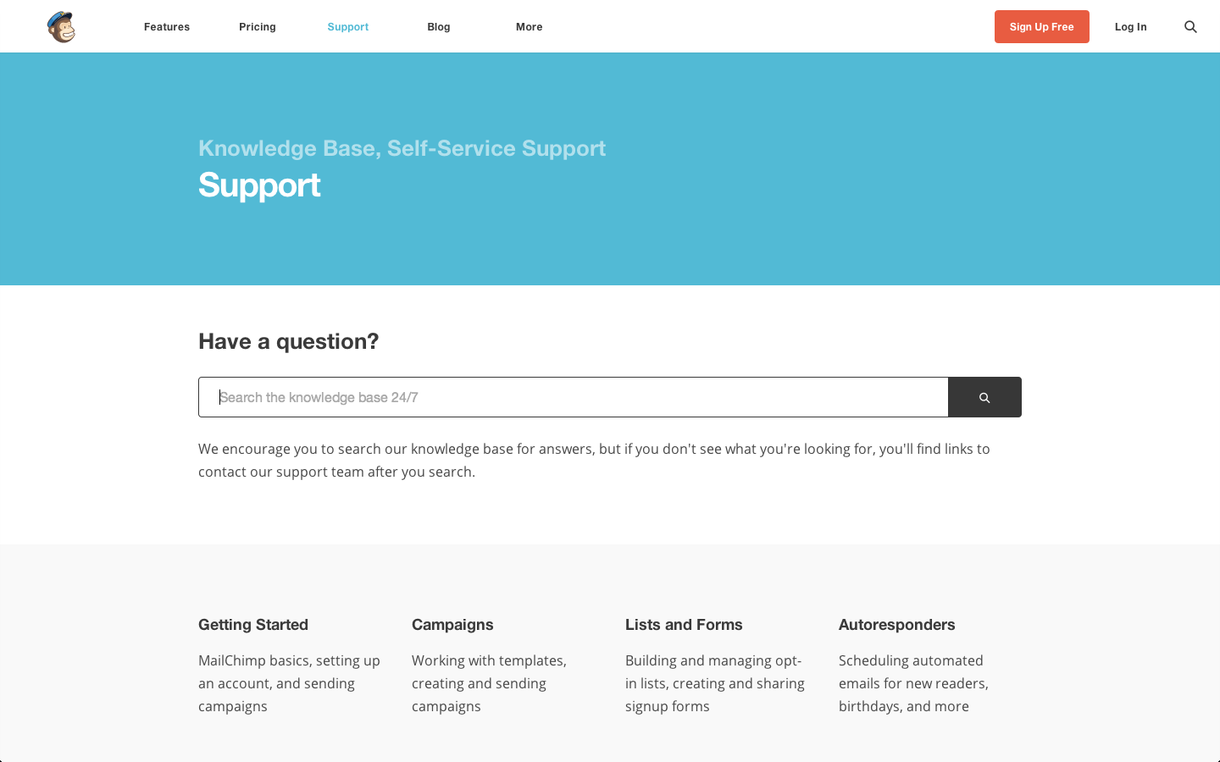

Slide 6
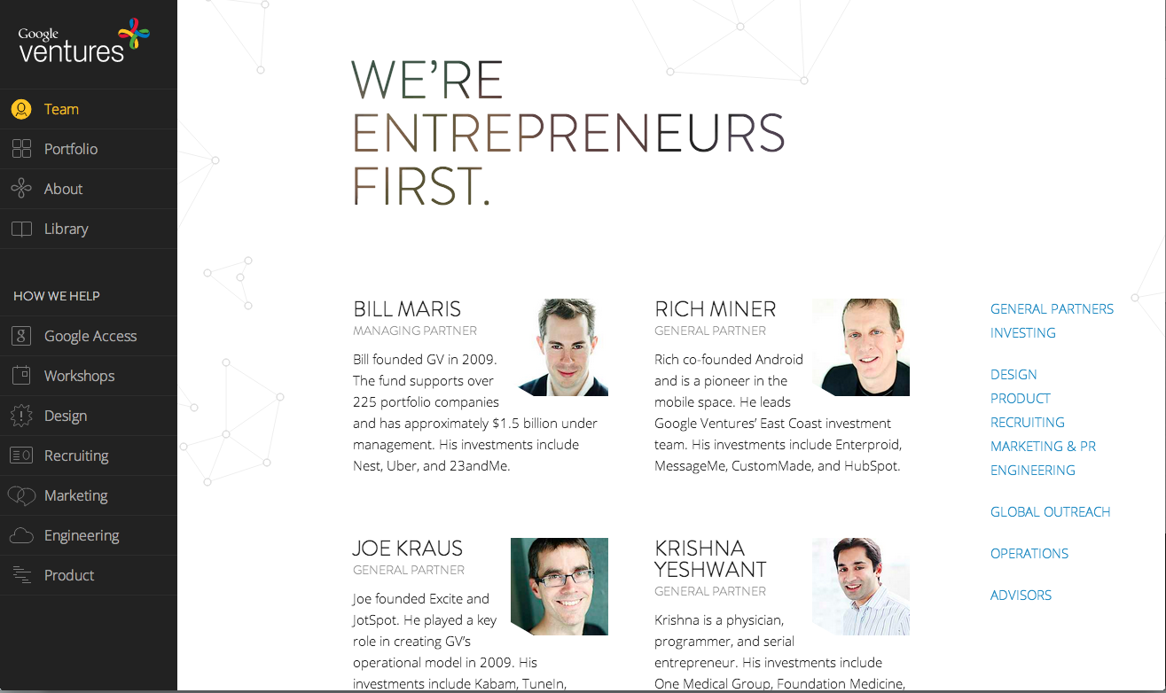

Slide 7


Slide 8
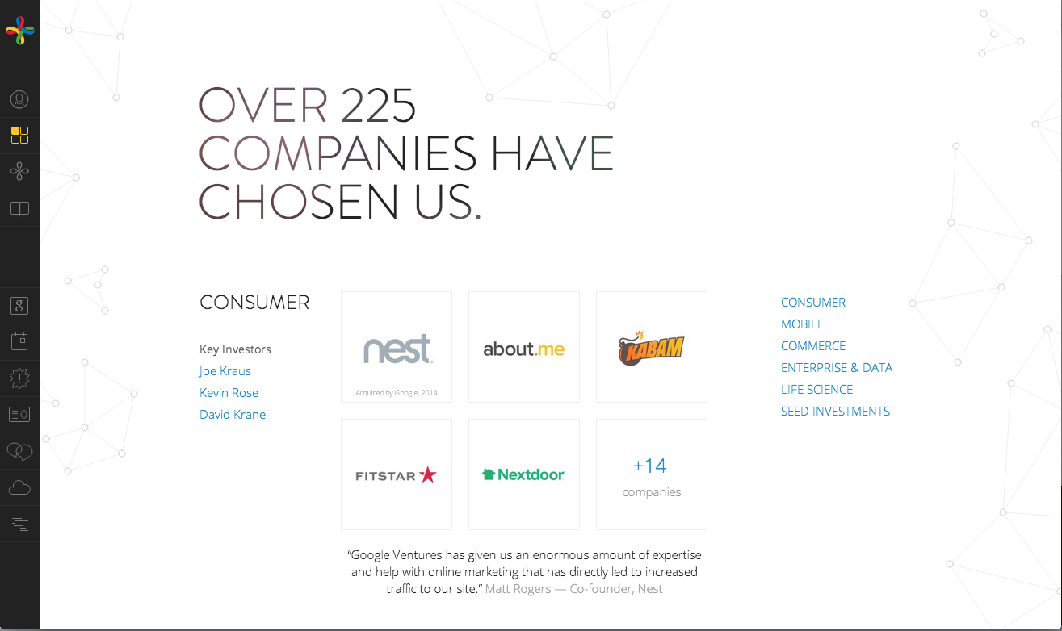

Slide 9
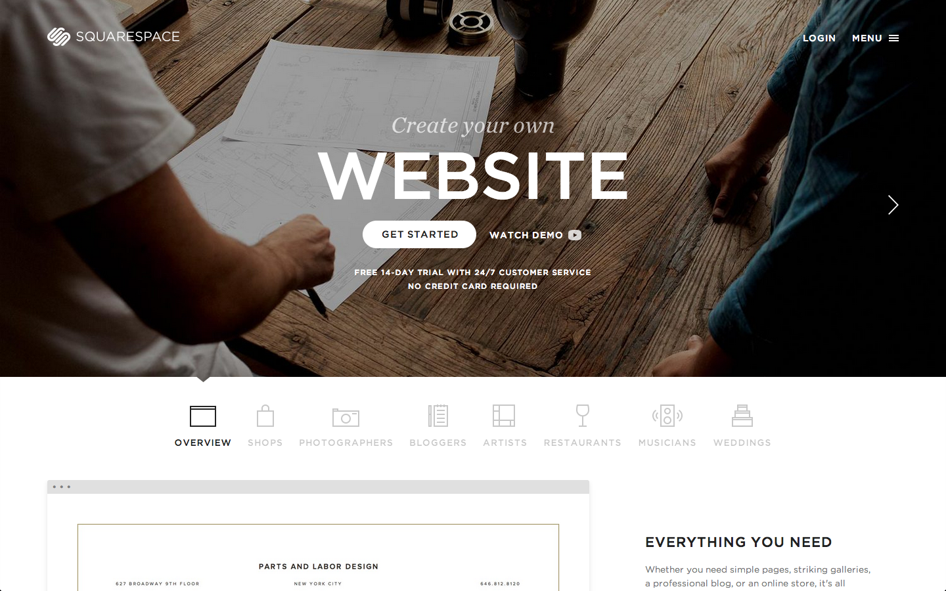

Slide 10


Slide 11


Slide 12
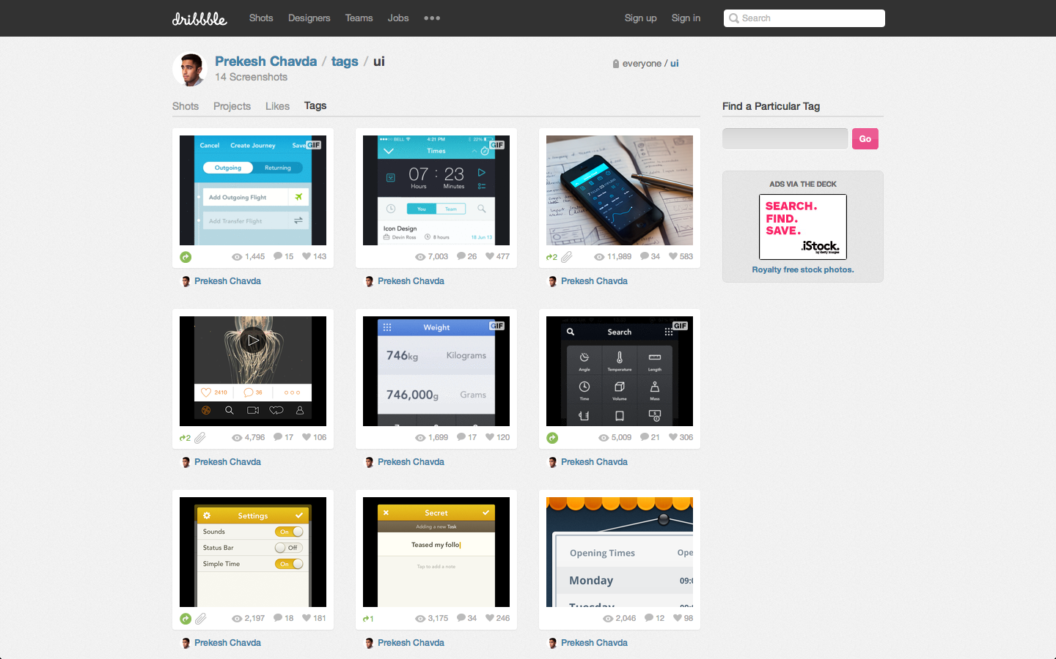

Slide 13
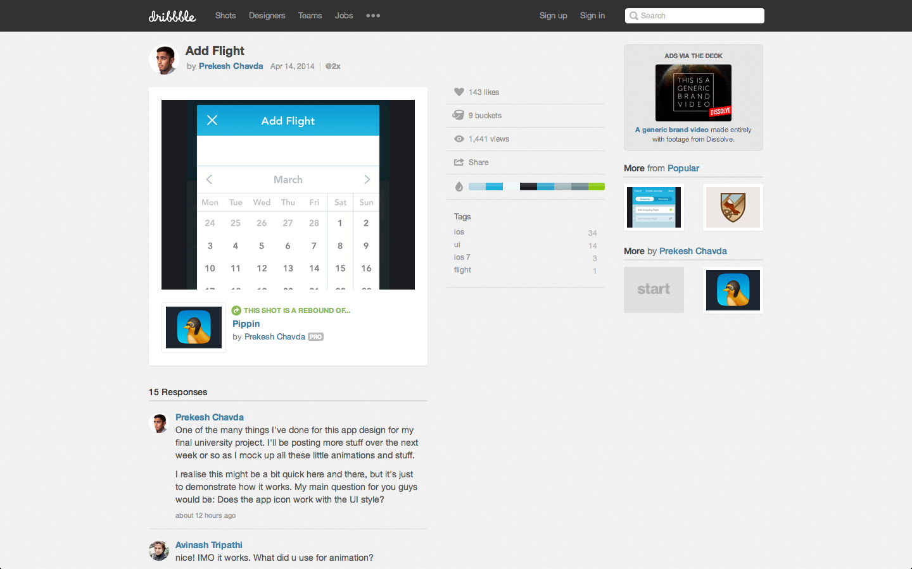

Slide 14
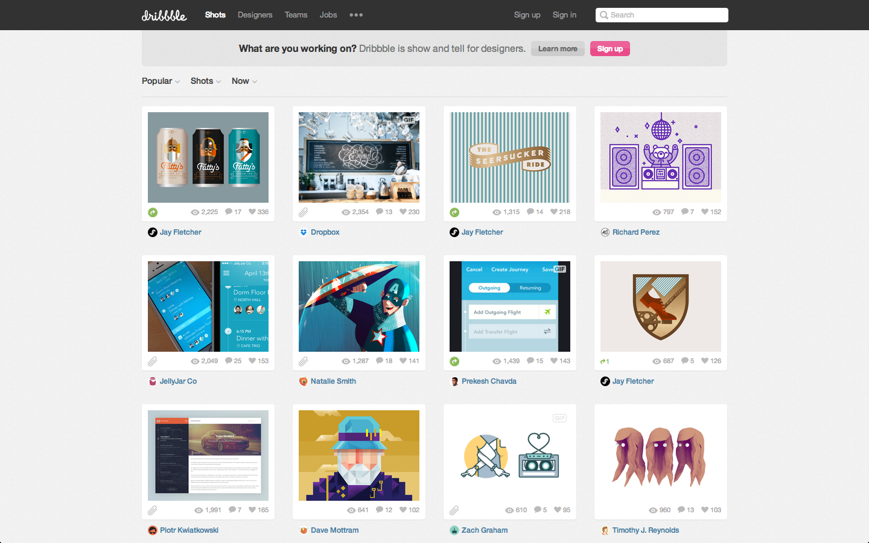

Slide 15
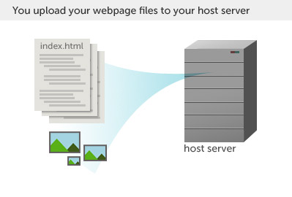
We live here!
Notes:
A website is simply a collection of files that live on a web server- a physical computer that stores and servers up your files.

Slide 16
Shopping Tips
24/7 Customer support phone #
Under $10 per month
Length of contract (min. class duration)
Domain name included?
Domain name ~$10-15/yr
No extras

Slide 17
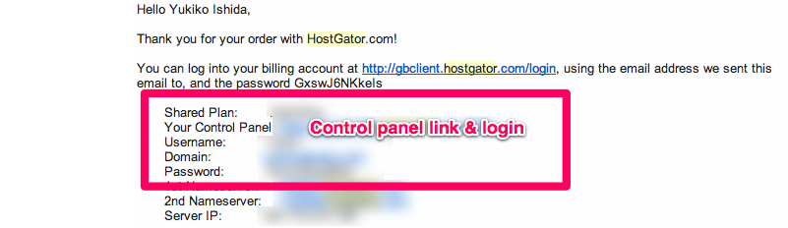
Control panel links

Slide 18
Test your login!
<Insert hostgator login screen here.>
<insert cpanel success page>

Slide 19
Before Next class
Purchase hosting
Purchase domain name
Login to your control panel (bring login info to class)

